Slide 1

Scan Conversion Prepared by: Md. Kishor Morol
CSC 4122: Computer Graphics

Slide 2
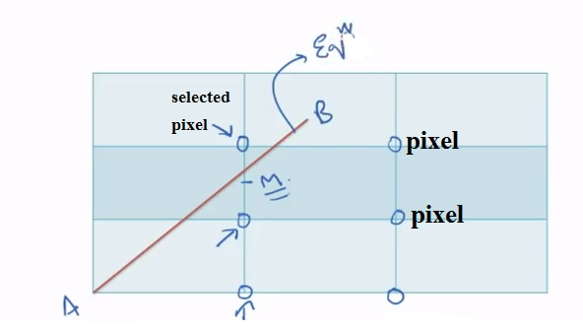
Midpoint Line Algorithm

Slide 3
Equation of Line
y=mx+B
m= slope
B=y intersect

Slide 4
Write Function in a line
F(x,y)= ax+by+c = 0

Slide 5
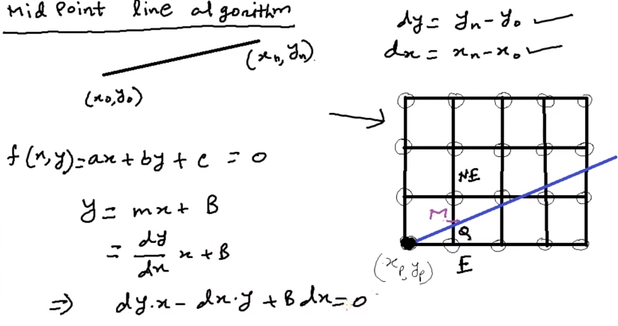

Slide 6
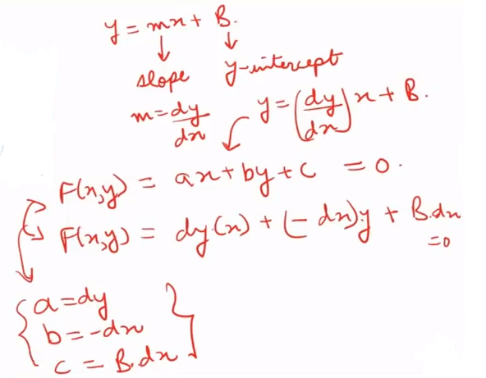

Slide 7
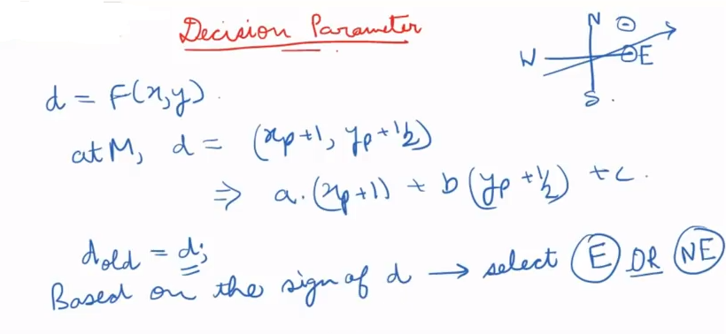

Slide 8
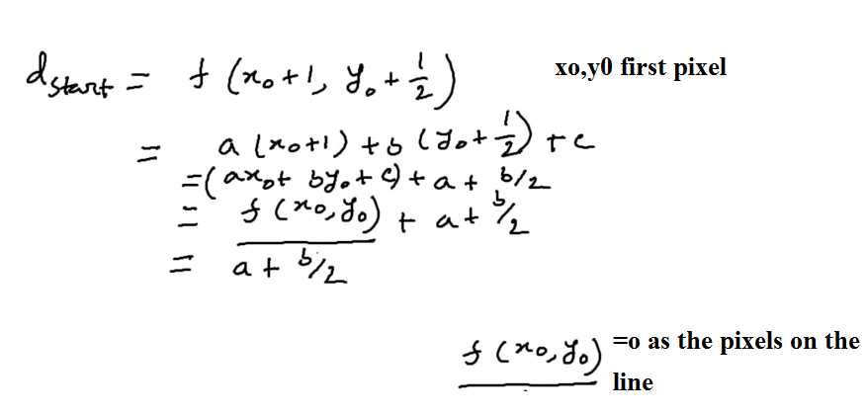
Dstart/initial

Slide 9
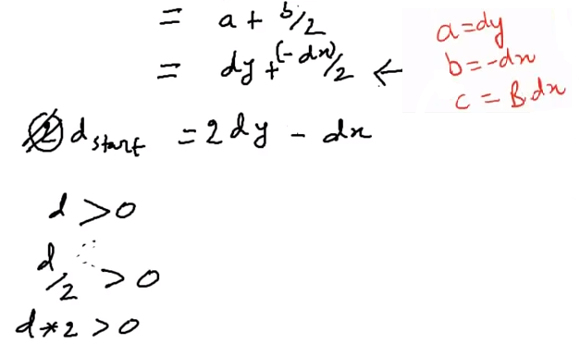
dstart

Slide 10
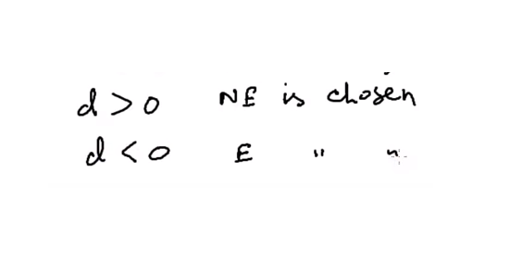
How to chose E and NE

Slide 11
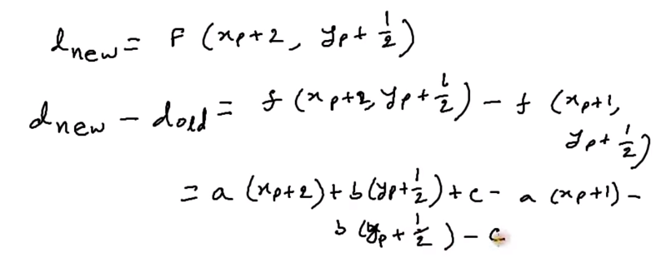
If E Chosen

Slide 12
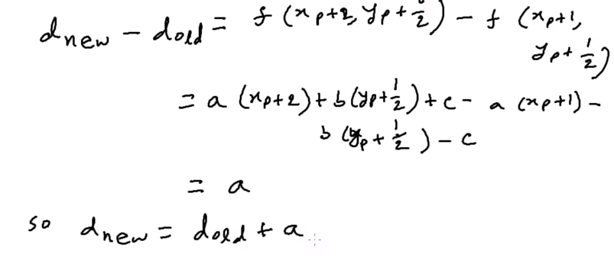
E Chosen

Slide 13
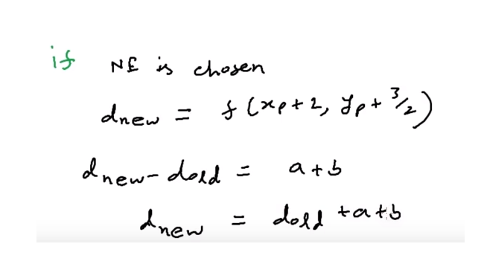
If NE Chosen

Slide 14
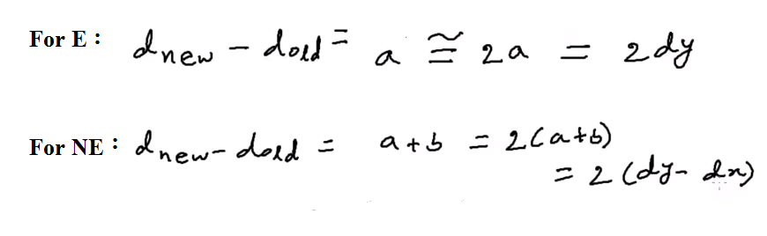
Adjustment with value 2

Slide 15
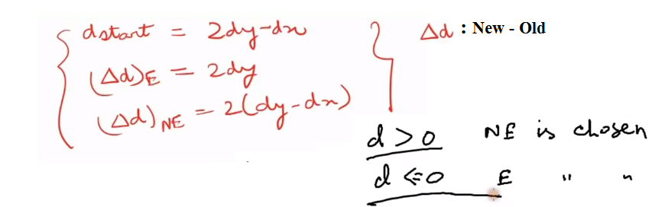
Summary

Slide 16
Advantages…
Incremental Method
No Round Function
Only Arithmetic Function

Slide 17
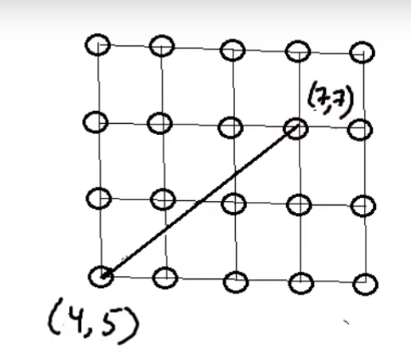
Example of Midpoint Line Algorithm

Slide 18
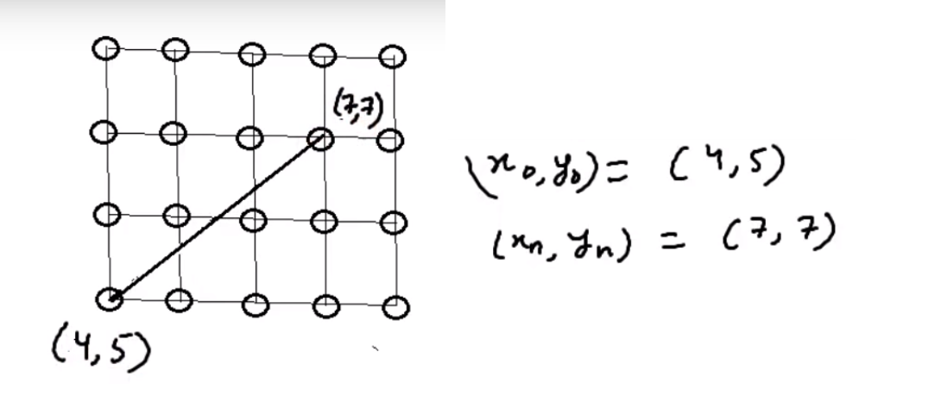

Slide 19
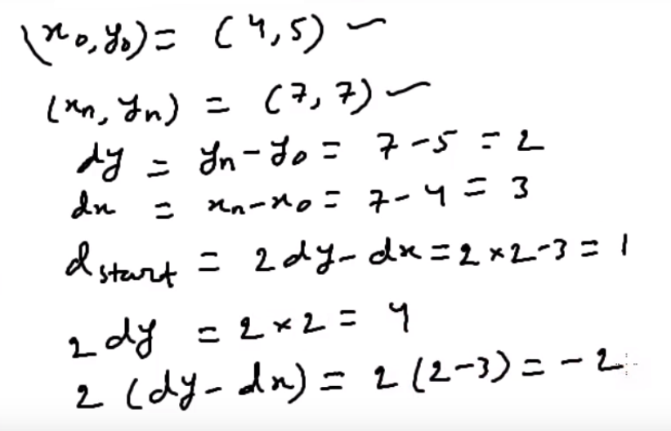

Slide 20
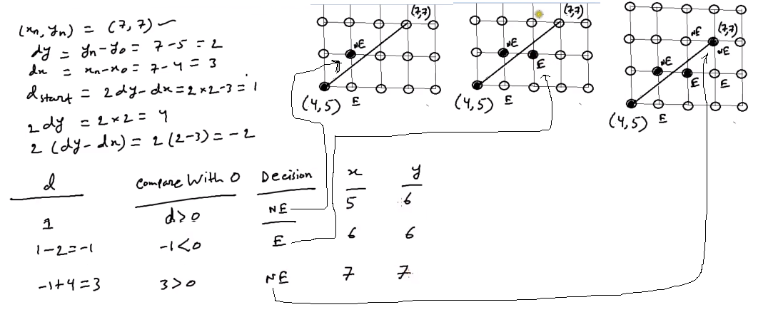

Slide 21
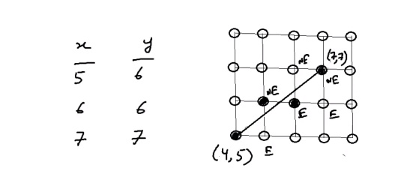
Summary

Slide 22
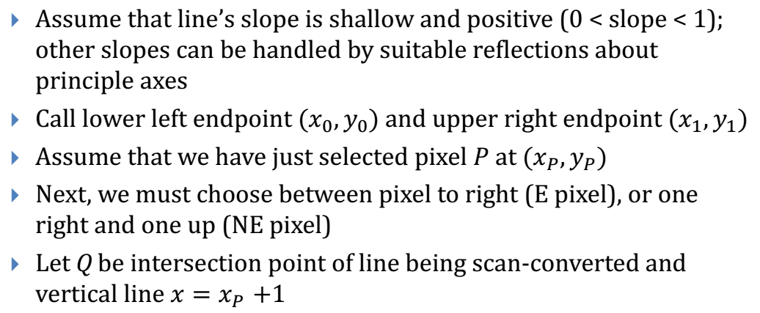
Strategy 2 – Mid Point Line Algorithm

Slide 23
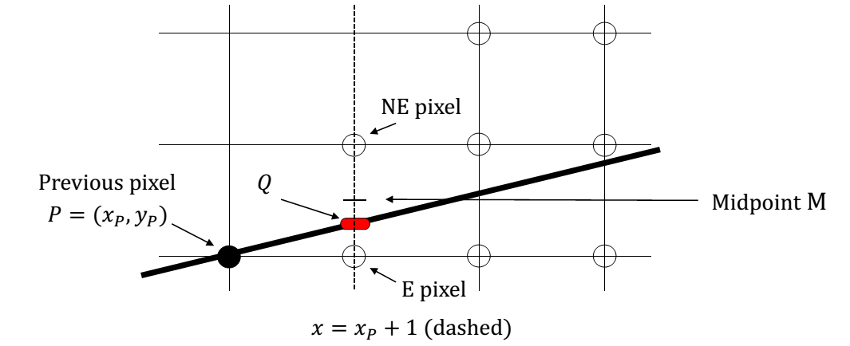
Strategy 2 – Mid Point Line Algorithm (Contd..)

Slide 24
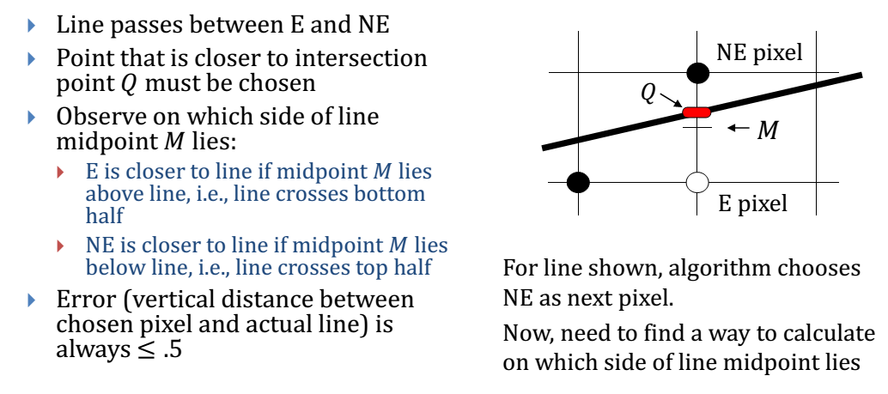
Strategy 2 – Mid Point Line Algorithm (Contd..)

Slide 25
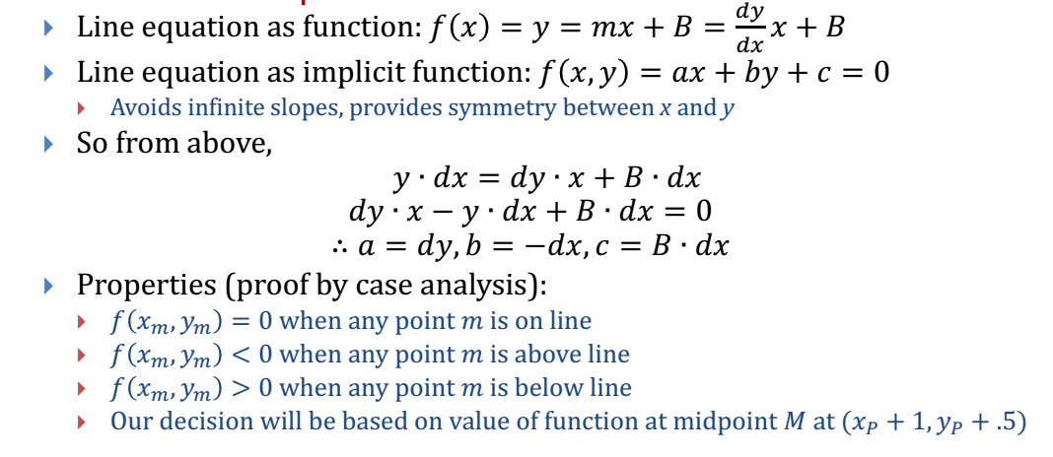
General Line Equation

Slide 26
Decision parameter
d = F(X,Y)
At M, d = (Xp +1, Yp +1/2)
= a(Xp +1) + b(Yp +1/2) + C
d_{old} = d

Slide 27
Summary- Mid Point Line
P=(x_{p}, y_{p}) is pixel chosen by the algorithm in previous step
To calculate d incrementally we require d_{new}
If d > 0 then choose NE
If d < 0 then choose E
If E, d_{new} = F(X_{p} + 2, Y_{p} + 1/2)
= a(X_{p} + 2) + b(Y_{p} +1/2) +c
Дd_{E} = d_{new -} d_{old} = a = d_{y}
If NE, d_{new} = F(X_{p} + 2, Y_{p} + 3/2)
= a(X_{p} + 2) + b(Y_{p} +3/2) +c
Дd_{NE} = d_{new -} d_{old} = a+b = d_{y -} d_{x}
M_{NE}
NE
M
E
y_{p}
P=(x_{p}, y_{p})
x_{p}
x_{p}+1
x_{p}+2
Previous
Current
Next

Slide 28
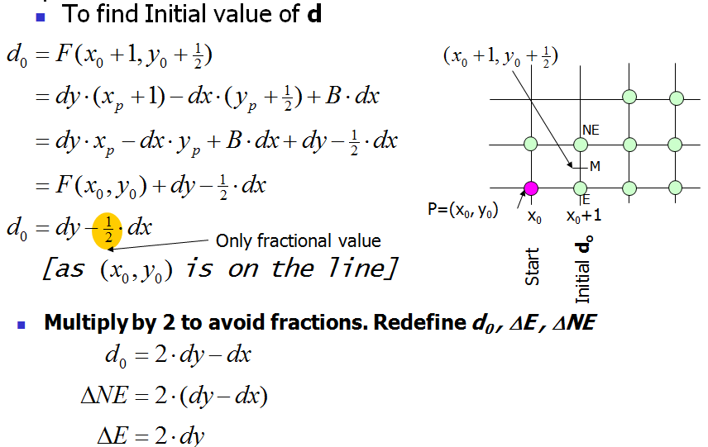
Summary- Mid Point Line (contd..)

Slide 29
Midpoint circle algorithm
In computer graphics, the midpoint circle algorithm is an algorithm used to determine the points needed for rasterizing a circle. Bresenham's circle algorithmis derived from the midpoint circle algorithm

Slide 30
Rasterisation
Rasterisation (or rasterization) is the task of taking an image described in a vector graphics format (shapes) and converting it into a raster image (pixels or dots) for output on a video display or printer, or for storage in a bitmap file format.

Slide 31
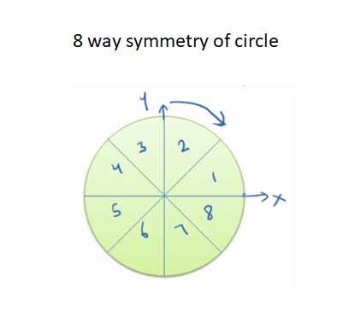
Midpoint Circle Algorithm

Slide 32
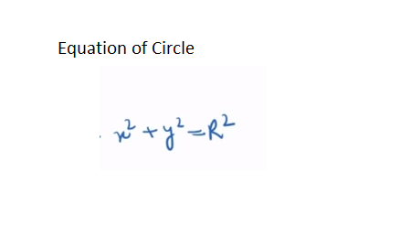

Slide 33
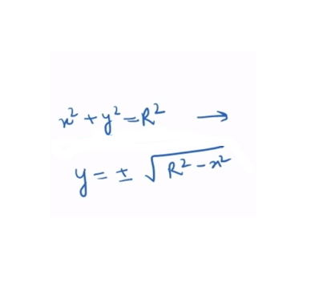

Slide 34
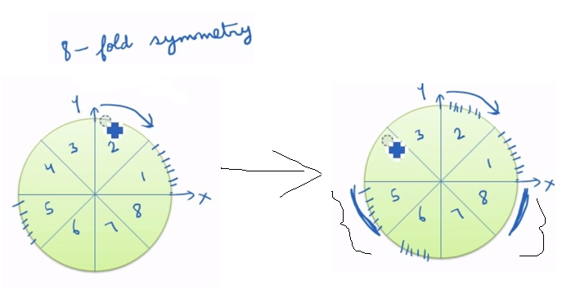

Slide 35
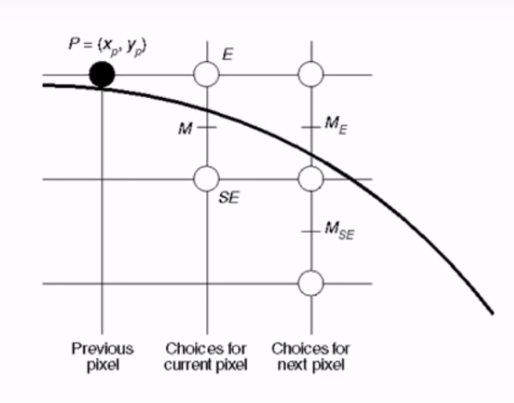

Slide 36
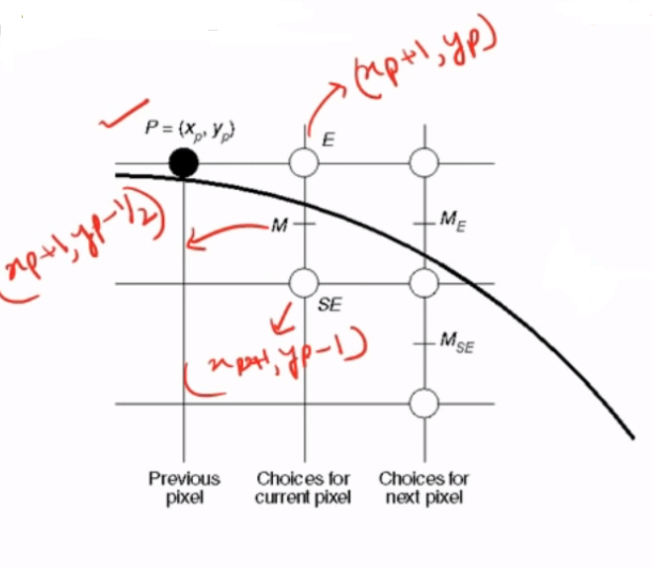

Slide 37
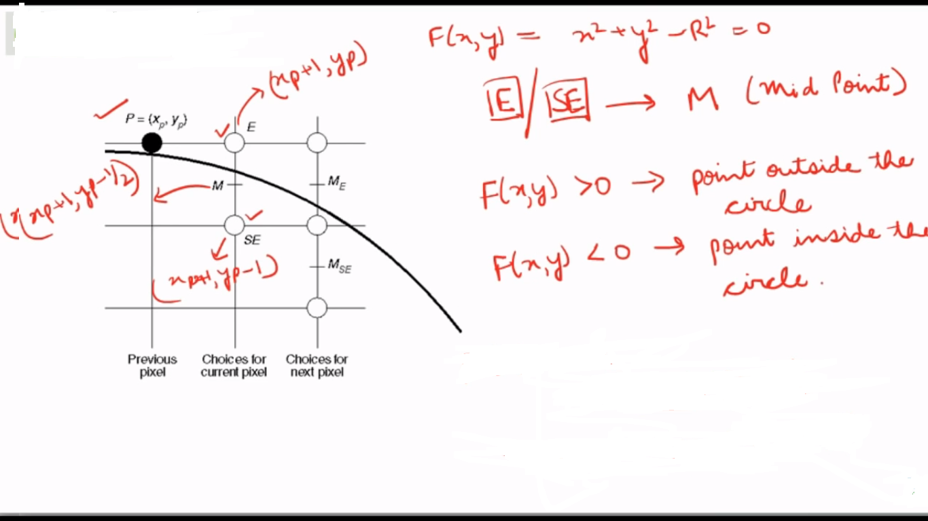

Slide 38
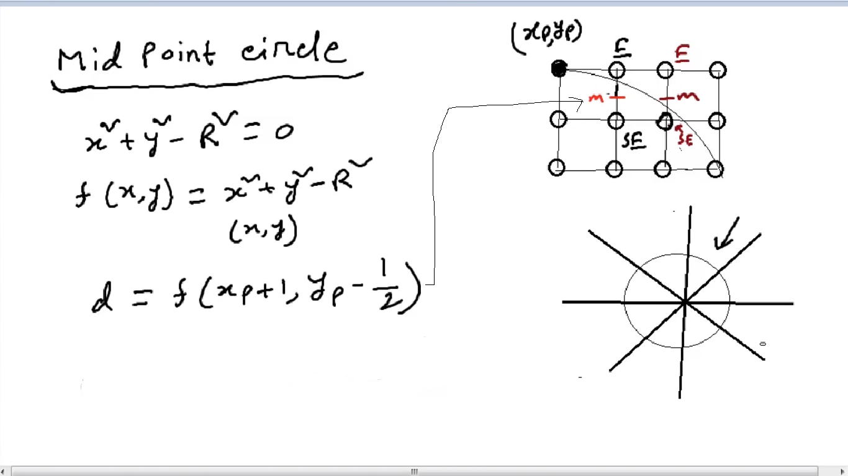

Slide 39
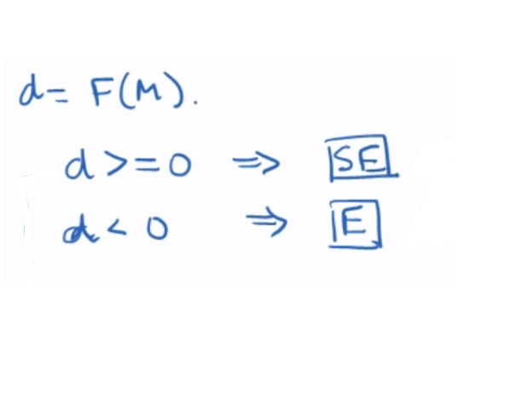

Slide 40
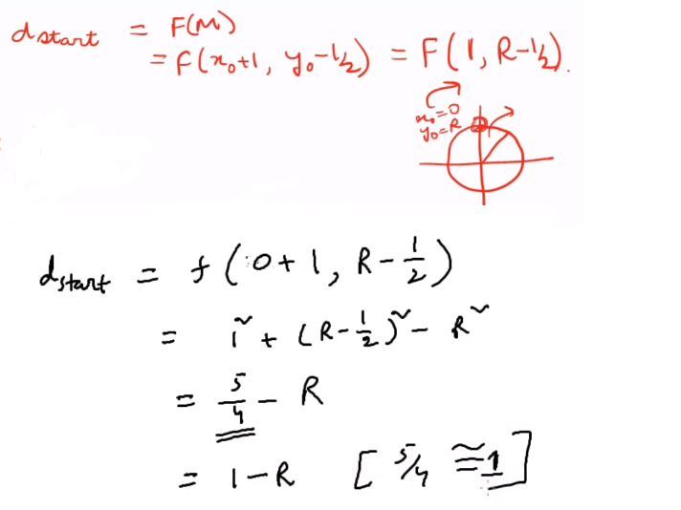
dStart

Slide 41
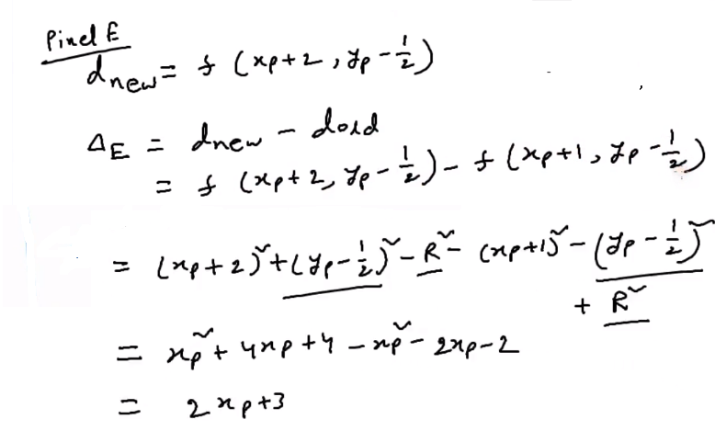
IF E Selected

Slide 42
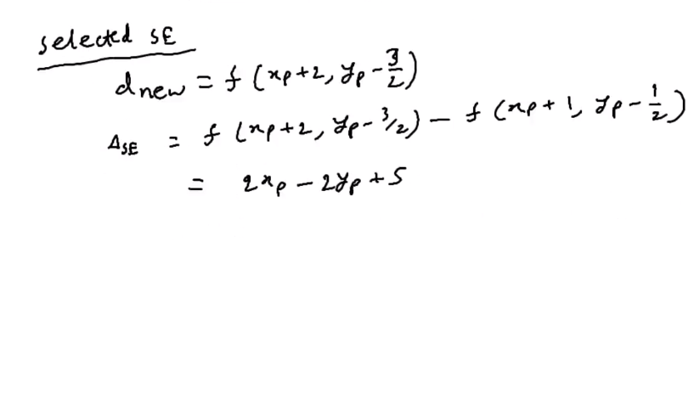
IF SE Selected

Slide 43
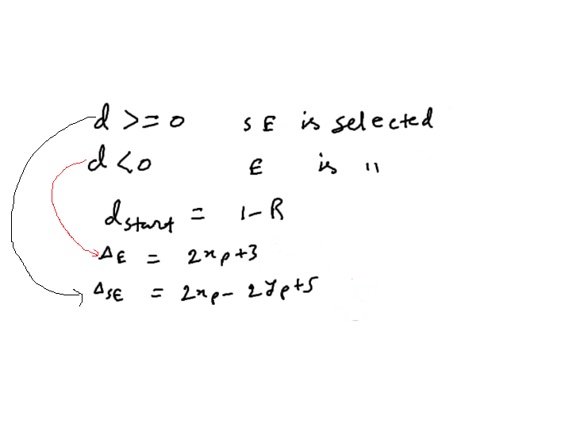
Summary

Slide 44
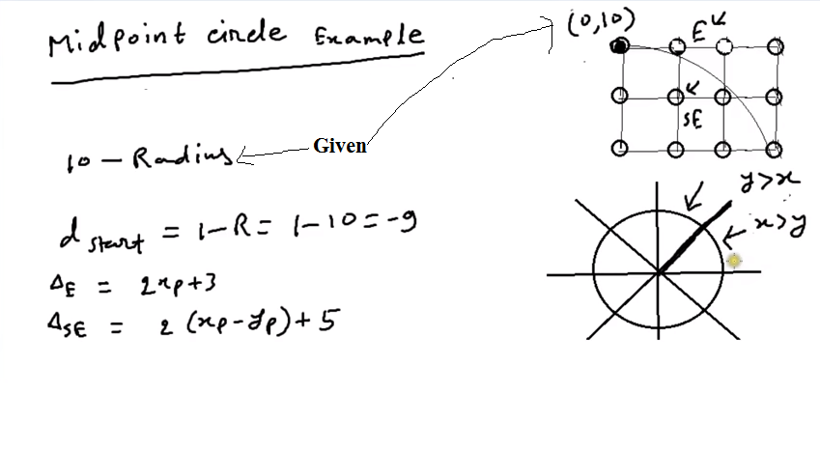
Midpoint Circle (Problem) with center 0,0

Slide 45
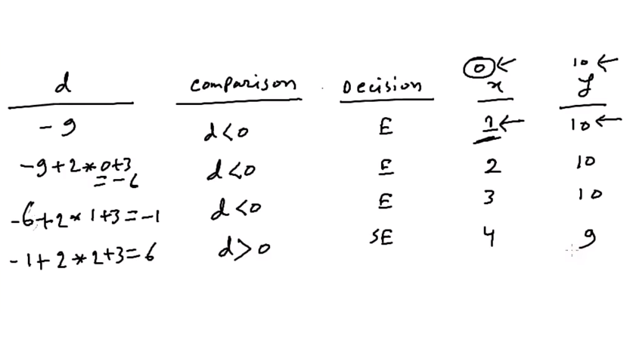

Slide 46
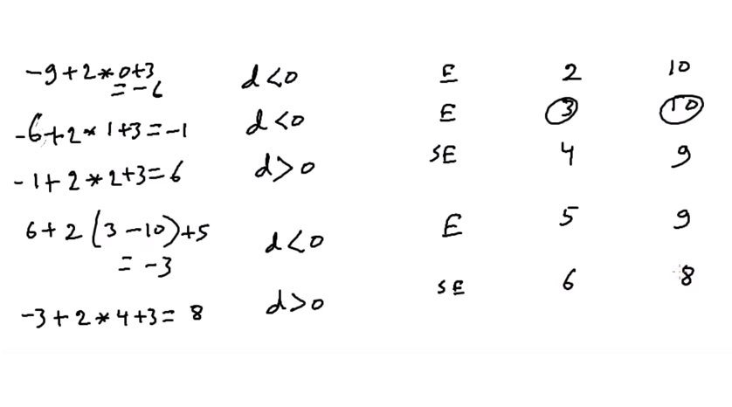

Slide 47
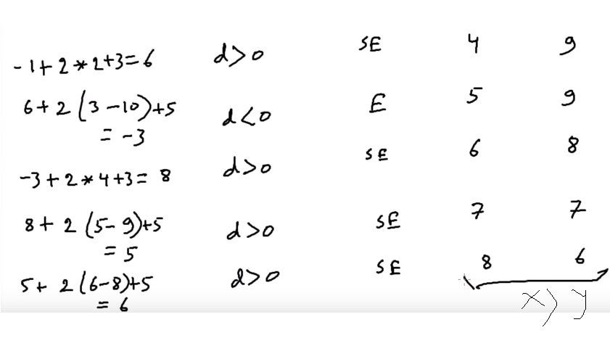

Slide 48
Final Coordinate for the octen
(x,y)= (1,10)
(2,10)
(3,10)
(4,9)
(5,9)
(6,8)
(7,7)

Slide 49
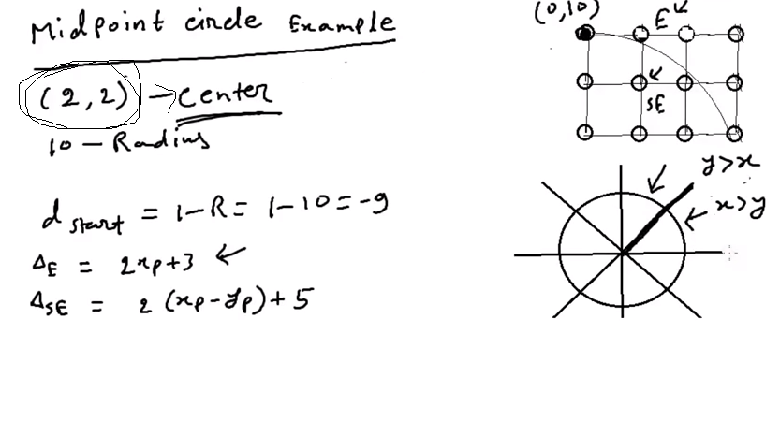
If Center is given intially

Slide 50
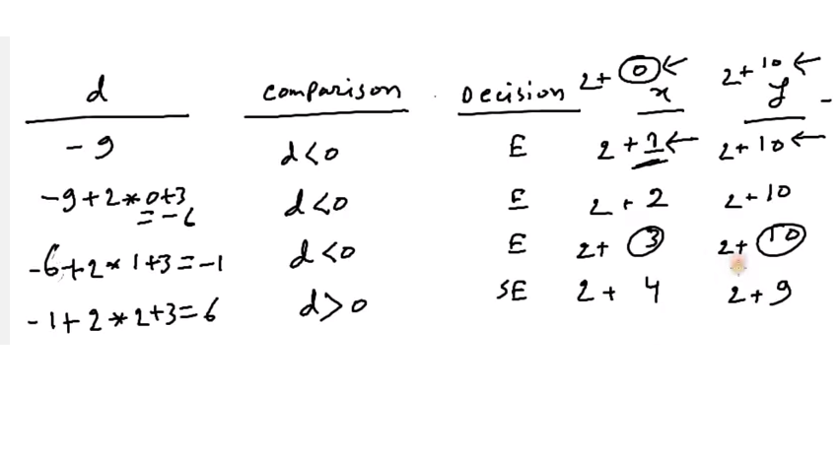

Slide 51
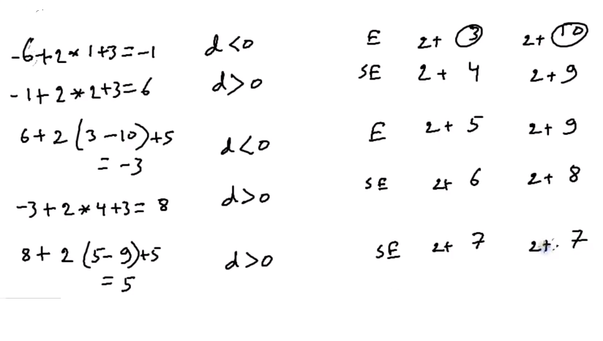

Slide 52
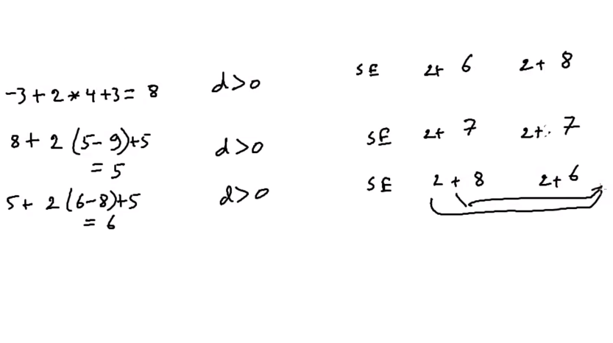

Slide 53
Final Coordinate with Center 2,2
(x,y)= (3,12)
(4,12)
(5,12)
(6,11)
(7,11)
(8,10)
(9,9)

